Slide 1


DATA COMMUNICATION
CSE 225/233
WEEK-9, LESSON-1 & 2
MULTIPLEXING

Slide 2
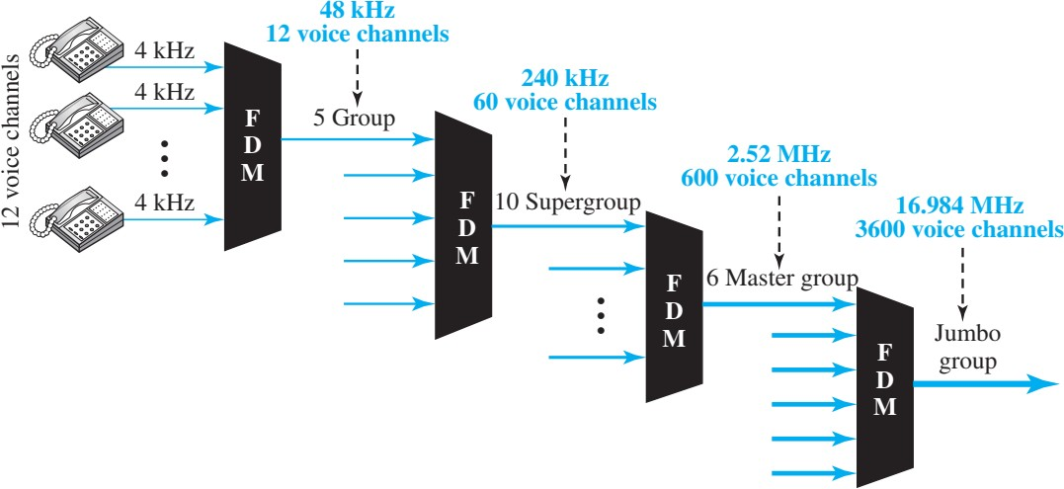
Analog Hierarchy

Slide 3
Applications of FDM
FDM is AM and FM radio broadcasting
Television Broadcasting
First Generation Cellular Phone

Slide 4
Example (3)
The Advanced Mobile Phone System (AMPS) uses two bands. The first band of 824 to 849 MHz is used for sending, and 869 to 894 MHz is used for receiving. Each user has a bandwidth of
30 kHz in each direction. How many people can use their
cellular phones simultaneously?
Solution
Each band is 25 MHz. If we divide 25 MHz by 30 kHz, we get
833.33. In reality, the band is divided into 832 channels. Of these, 42 channels are used for control, which means only 790 channels are available for cellular phone users.
Data Communication Lecture Series, MFH, MAY2021

Slide 5
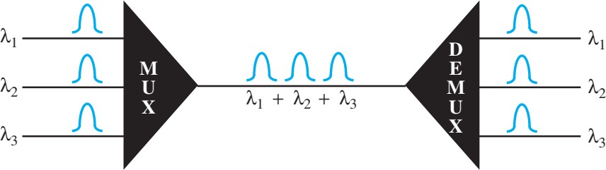
Wavelength Division Multiplexing (WDM)
Wavelength-division multiplexing (WDM) is designed to use the high-data-rate capability of fiber-optic cable. The optical fiber data rate is higher than the data rate of metallic transmission cable but using a fiber-optic cable for a single line wastes the available bandwidth. Multiplexing allows us to combine several lines into one.
Data Communication Lecture Series, MFH, MAY2021

Slide 6
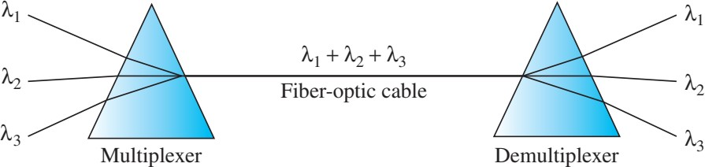
Prism in WDM- MUX and DEMUX
Data Communication Lecture Series, MFH, MAY2021

Slide 7
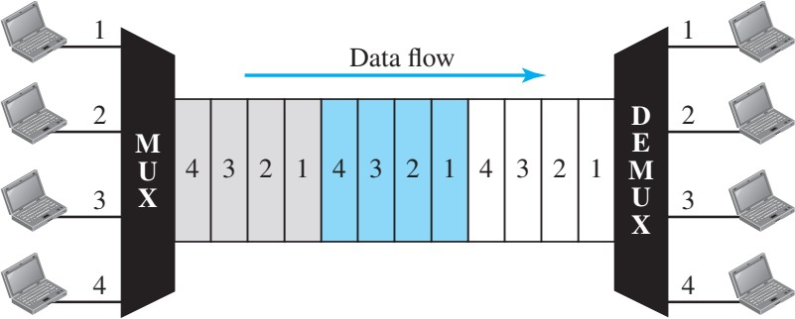
Time Division Multiplexing (TDM)
Time-division multiplexing (TDM) is a digital process that allows several connections to share the high bandwidth of a link. Instead of sharing a portion of the bandwidth as in FDM, time is shared. Each connection occupies a portion of time in the link.
Data Communication Lecture Series, MFH, MAY2021

Slide 8
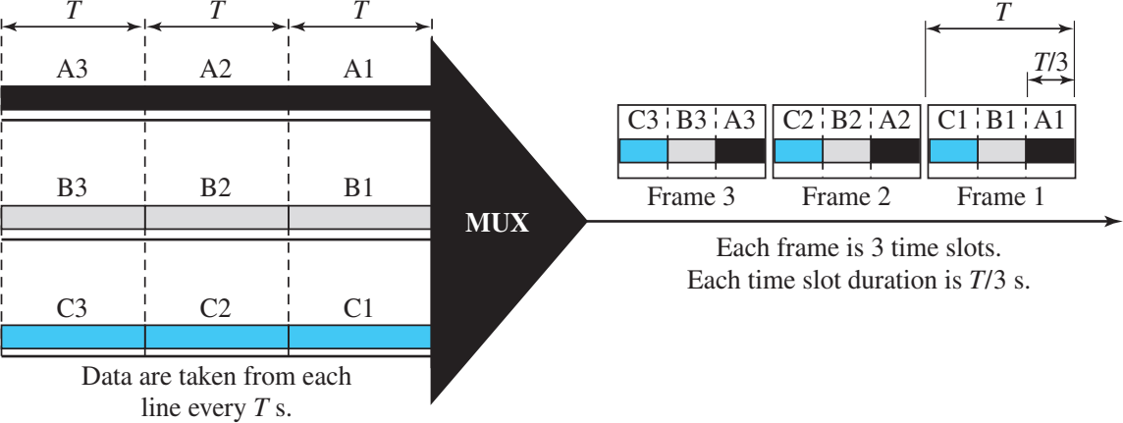
Synchronous Time Division Multiplexing (TDM)
In synchronous TDM, the data rate of the link is n times faster, and the unit duration is n times shorter.
Data Communication Lecture Series, MFH, MAY2021

Slide 9
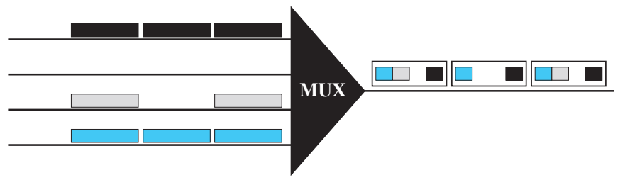
Empty Slots
Synchronous TDM is not as efficient as it could be. If a source does not have data to send, the corresponding slot in the output frame is empty. Following figure shows a case in which one of the input lines has no data to send and one slot in another input line has discontinuous data. The first output frame has three slots filled, the second frame has two slots filled, and the third frame has three slots filled. No frame is full.
Data Communication Lecture Series, MFH, MAY2021

Slide 10
Data Rate Management
One problem with TDM is how to handle a disparity (inequality) in the input data rates. In all our discussion so far, we assumed that the data rates of all input lines were the same. However, if data rates are not the same, three strategies, or a combination of them, can be used. We call these three strategies multilevel multiplexing, multiple-slot allocation, and pulse stuffing.
Data Communication Lecture Series, MFH, MAY2021

Slide 11
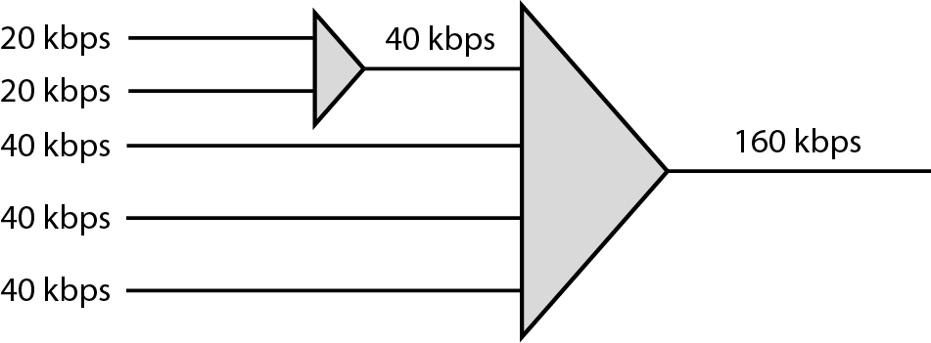
Multilevel Multiplexing
Multilevel multiplexing is a technique used when the data rate of an input line is a multiple of others. For example, in the following figure, we have two inputs of 20 kbps and three inputs of 40 kbps. The first two input lines can be multiplexed together to provide a data rate equal to the last three. A second level of multiplexing can create an output of 160 kbps.
Data Communication Lecture Series, MFH, MAY2021

Slide 12
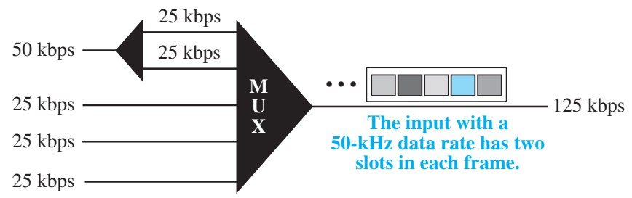
Multiple Slot
Sometimes it is more efficient to allot more than one slot in a frame to a single input line. For example, we might have an input line that has a data rate that is a multiple of another input. In the following figure, the input line with a 50-kbps data rate can be given two slots in the output. We insert a demultiplexer in the line to make two inputs out of one.
Data Communication Lecture Series, MFH, MAY2021

Slide 13
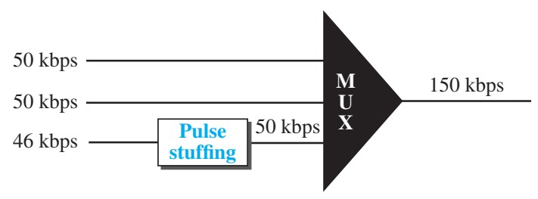
Pulse Stuffing
Sometimes the bit rates of sources are not multiple integers of each other. Therefore, neither of the above two techniques can be applied. One solution is to make the highest input data rate the dominant data rate and then add dummy bits to the input lines with lower rates. This will increase their rates. This technique is called pulse stuffing, bit padding, or bit stuffing. The idea is shown in the following figure. The input with a data rate of 46 is pulse-stuffed to increase the rate to 50 kbps. Now multiplexing can take place.
Data Communication Lecture Series, MFH, MAY2021

Slide 14
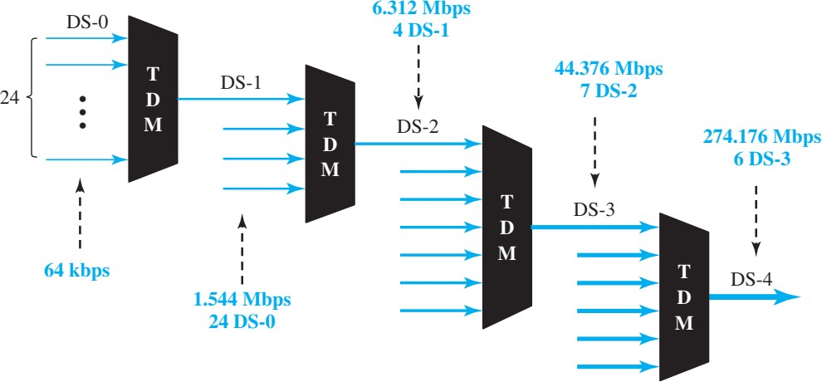
Digital Hierarchy
Data Communication Lecture Series, MFH, MAY2021

